Slide 1
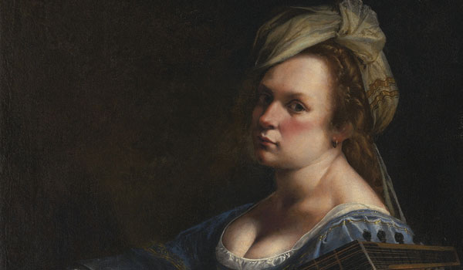
An “Uncommon Woman”
MODERN MONA
2016

Slide 2
The Baroque Period
The Baroque period is often thought of as a period of artistic style that used exaggerated motion and clear, easily interpreted detail to produce drama, tension and exuberance in sculpture, painting, architecture, literature, dance, theater, and music.
In fine art, the term Baroque Period in Italy flowered during the period c.1590-1720, which embraced painting, and sculpture as well as architecture. After the idealism of the Renaissance (c.1400-1530), Baroque art above all reflected the religious tensions of the age - notably the desire of the Catholic Church in Rome to reassert itself in the wake of the Protestant Reformation.
Along with this monumental, high-minded approach, painters typically portrayed a strong sense of movement, using swirling spirals and upward diagonals, and strong sumptuous colour schemes, in order to dazzle and surprise. New techniques of Chiaroscuro were developed to enhance atmosphere. Brushwork is creamy and broad, often resulting in thick impasto.
Artists such as Caravaggio and Gentileschi, their paintings were dramatic, theatrical and created illusion, often deriving from high tonal contrast.
Their subject matter included biblical characters, architecture, spatial illusion, large gardens, grandiose curved exterior staircases.
with

Slide 3
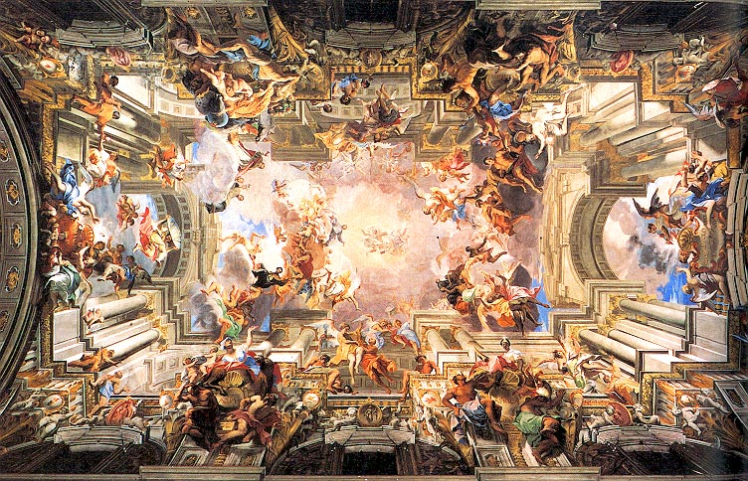
An artwork painted in ‘typical’ Baroque style
Andrea Pozzo, St Ignatius, 1691

Slide 4
Artemisia Gentileschi
Key Dates
Born in 1593 in Rome
Trained by her father Orazio as a painter. It was highly unusual, though not unprecedented for a woman to paint. Artemisia broke free of the traditional restrictions placed on women artists.
Painted her first ‘masterpiece’, Susanna and the Elders in 1610 when she was 17 years old
Raped by Agostino Tassi in 1612 – her art tutor
Painted Judith Slaying Holofernes in 1613
Married in 1614; moved to Florence; had a daughter named Palmira
Became a member of the Florence Academy of Design in 1616, a remarkable achievement
Returned to Rome in 1621 after death of her patron
Moved to Genoa in 1621; painted Lucretia
Returned to Rome; separated from husband; had another daughter
Moved to Naples between 1626-30 where she remained until 1638
Received patronage from King Charles I of England from 1638-41
Returned to Naples where she lived until her death in 1652

Slide 5
Artemisia Gentileschi
Artistic Style
Worked with the Chiaroscuro style, influenced by Caravaggio
Dramatic realism based on biblical, primarily Old Testament stories
Mythological female narratives in both heroic and tragic themes
Women generally were not allowed to paint nudes, so they were restricted to ‘lower’ subjects such as still life and portraiture. Artemesia broke through this restriction.
Female heroines are generally quite fleshy, sensual, rounded and feminine, but are not passive victims or stereotypes. They use their intelligence, display courage and are virtuous. Artemesia seems to identify directly with these heroines
Often depicted scenes in the ‘decisive, contemplative moment’, emphasising the decision-making powers of her heroines. Themes are often quite violent.
Paintings often display strong diagonals and sweeping curves, which create movement and add to the Baroque ‘theatricality’
Figures emerge from deep shadows; heavily cropped compositions; space is often quite shallow and figures are near the frontal plane
Highly skilled at rendering figures, drapery and details such as jewelry.

Slide 6
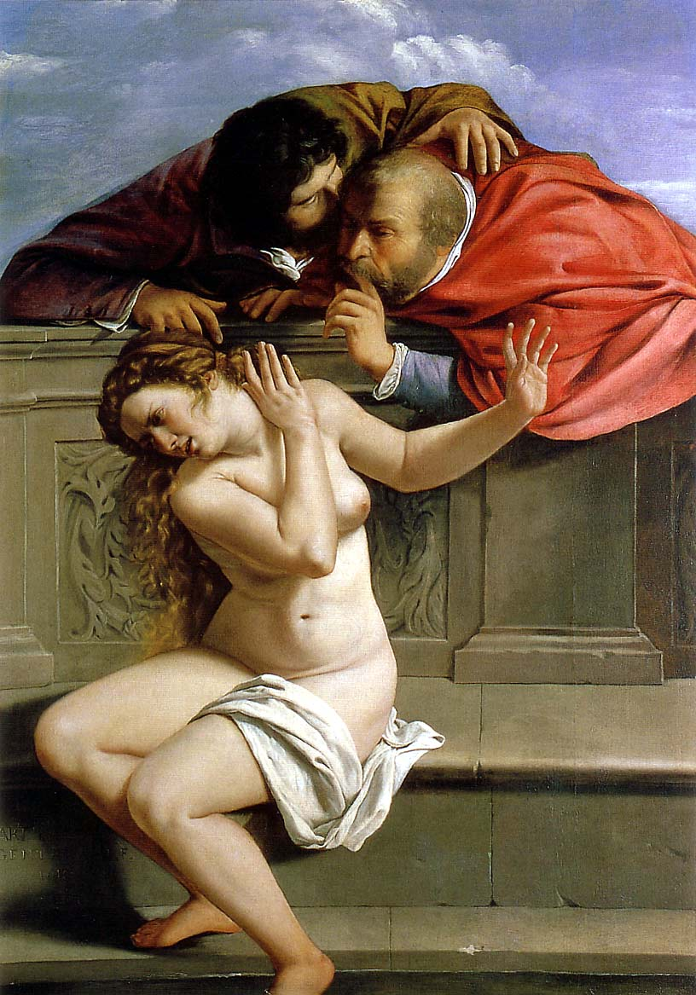
Artemisia Gentileschi, Susannah and the Elders, 1610
The story of Susannah and the Elders is an instructive moral tale about lust and the corruption of officials. Susannah, whilst bathing naked, was spied upon by two elders of her tribe. When she confronted them they threatened to blackmail her if she refused to sleep with them. She refused and they accused her publicly of having committed adultery. For this she was condemned to death. The young Prophet Daniel was unconvinced of her guilt and decided to question each elder separately. He found serious inconsistencies in their accounts of what they had supposedly witnessed together. They in turn were sentenced to death and Susannah was freed and her reputation restored.

Slide 7
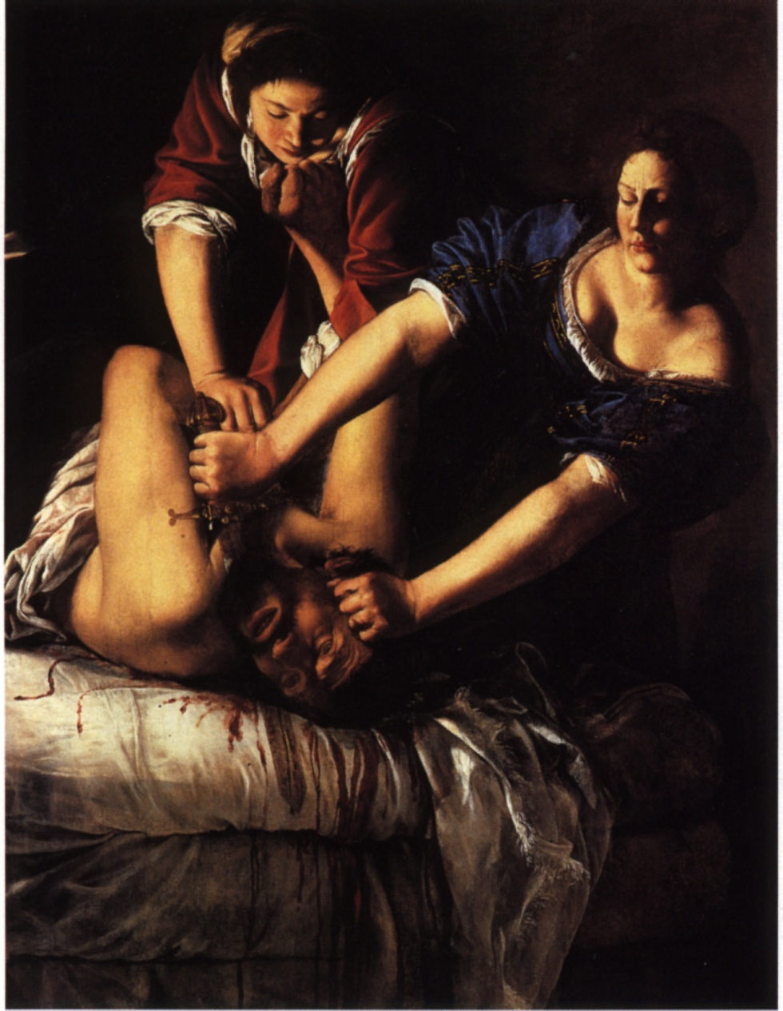
Artemisia Gentileschi, Judith Slaying Holofernes, 1612
Artemisia may have painted this scene during or just after the trial of Agostino Tassi for raping her. He denied the charges but couldn't shrug off his record of sex crimes. He had previously served time for raping his sister-in-law and conspiring to murder his wife, whom he "acquired" by rape.
It appears that after a long period of sexual harassment by Tassi in her father’s studio, he violated Artemisia's virginity. A consensual sexual relationship continued because he promised to marry her. It is likely that Artemisia hoped that he would marry her to restore her reputation. Her father discovered the assault and charged Tassi with rape, largely to attempt to recover ‘lost’ income and personal property in Tassi’s possession.
The trial was a painful public humiliation for Artemisia. During the proceedings, she underwent vaginal examination and torture with thumbscrews. A transcript of the seven-month court case survived.
It was not until recent years that research revealed that Tassi was found guilty. He was given the choice of five years hard labour or exile from Rome. He chose the exile, but he was back in Rome within 4 months, probably due to influence in high places.

Slide 8
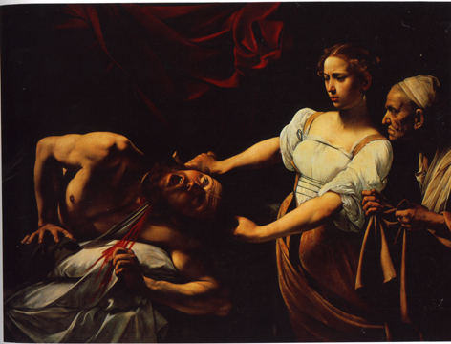
Comparing Caravaggio & Gentileschi
Caravaggio, Judith Slaying Holofernes
Gentileschi, Judith Slaying Holofernes

Slide 9
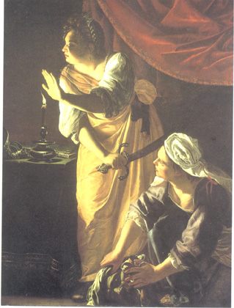
Artemisia Gentileschi, Judith and her Maidservant with the Head of Holofernes, 1625

Slide 10
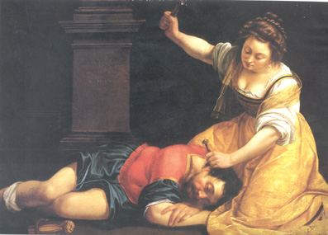
Artemisia Gentileschi, Jael and Sisera 1620
Artemisia chose another biblical theme picturing a woman slaying an aggressor. Sisera was a cruel Canaanite leader who ruled the Israelites for twenty years. Barak defeated his nine hundred charioteers by a surprise attack. Sisera escaped and sought refuge in the tent of Jael, wife of Heber the Kenite. She gave the terrified Canaanite sanctuary. When he fell asleep, she drove a tent peg into his brain. The act fulfilled the prediction of Debora, prophetess and Israelite leader, who foresaw that a woman would slay Sisera.

Slide 11
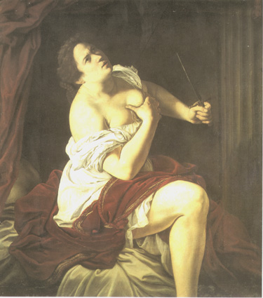
Lucretia is the legendary heroine of ancient Rome who is the quintessential virtuous wife. She was the beautiful wife of the nobleman Lucius Tarquinius Collatinus. Sextus Tarquinius, the son of the tyrant Etruscan king of Rome, raped her, and she committed suicide because of her perceived shame, but only after she exacted an oath of vengeance against the Tarquin family from her father and husband. The enraged populace rebelled against the Tarquins and drove them out in 509 B.C.E. and this event marks the beginning of the Roman Republic.
Artemisia Gentileschi, Lucretia 1621

Slide 12
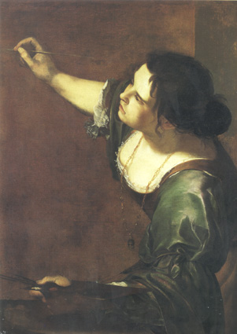
Artists in the Renaissance and Baroque were concerned with their identities as artists. Self portraits were extremely popular. Artists created an image of themselves in possession of the tools of the trade (i.e. brushes, paints, and palettes), clearly identifying the subject as an artist).
Artemisia Gentileschi holds a brush in one hand and a palette in the other, identifying herself as the female personification of painting. It was probably during her brief English sojourn (1638-c.1641) that Artemisia Gentileschi produced this painting. On one level the work depicts an allegorical/symbolic figure of Painting. She is also described as ‘a beautiful woman, with full black hair, dishevelled, and twisted in various ways, with arched eyebrows that show imaginative thought, with a chain of gold at her throat and steady hands. Artemisia captures the essentials of this description. The work is also, however, a self-portrait: as a woman artist. Artemisia identifies herself as the female personification of Painting. which would suggest the artist’s role.
Artemisia Gentileschi,
Self-Portrait As The Allegory Of Painting, 1630

Slide 13
PAINTING: TECHNICAL INFORMATION
Oil and acrylic paint is applied using a range of flat and round brushes (or a palette knife) directly onto a cotton or linen canvas. Whilst many artists ‘stretch’ their own canvas so as to get the exact size they wish, it is much more convenient for us to purchase pre-stretched canvases. Oil and acrylic paints can be applied directly from the tube but because they are quite thick, they are generally mixed with a ‘medium’ to thin them out. This also has the advantage of allowing the painter to work with more ‘transparent’ colours so as to blend them more effectively. Typically, oil paint is mixed with linseed oil, mineral turps or a combination of the two. Acrylic paint however is mixed with water. Oil paints can take weeks or months to fully dry, acrylic only takes a few minutes. Once fully dry, a ‘varnish’ can be painted over the entire surface to produce a shiny/glossy effect.

Slide 14
PAINTING GLOSSARY
Painting: Generally on a stretched canvas but may also be on a wall or board. Oil Paint dries slowly, can be built up in rich, transparent layers using medium, linseed oil and/or solvents such as turps. Oil paints are great for blending and can also be thickened and given a texture. It can be cleaned up with turps. Acrylic Paint dry quickly and tend to be rather flat and opaque. Although acrylics can be blended, many artists who work in this medium tend to prefer solid, flatter types of work, less texture. The layers are thin and cleaned up with water. Impasto refers to thick, paste-like paint often applied with a palette knife. Gesso is a paint used to seal and size (shrink & tighten) the canvas prior to working with oils or acrylics. Underpainting: applying a wash or thin coat of paint to the blank canvas; helps unify the painting by providing a base colour and blocking in the tones. It is required that the painting is built up in many layers. The detail comes last.

Slide 15
PAINTING TASK
You are to complete a practice painting / small study in preparation for a major painting task. In the context of painting or fine art ‘study’ is the term used for a practice piece, a quick painting done to capture the essence of a subject or scene.
Go to your email and open the Artemisia Gentileschi images that I have sent you
Select the Artemisia Gentileschi image you wish to use
Open it up in Photoshop, select the ‘Crop Tool’ from the toolbar on the left side
Select the area you wish to crop / paint, pick an area that has a lot of tonal / colour range
Save your image and print on A4 paper and paste into your visual diary (leave room for your final annotation)
Use the printed image as a guide and transfer to your A5 canvas
Begin painting: Block in general areas / tones
Add colours / tones to blend (refer to the colour wheel & painting techniques)
Use medium as desired for transparency Add in details and outlines last

Slide 16
This is a quick tutorial on how to create a small study:
https://www.youtube.com/watch?v=9n6VqY5cNwU

Slide 17
Don’t forget to annotate!
What did you do? E.g. what colours did you mix?
What do you like / dislike about it?
How would you improve on it? E.g. would you use a smaller brush for the more intricate details?
Don’t forget to incorporate how you used the elements and principles and artistic vocabulary.

Slide 18
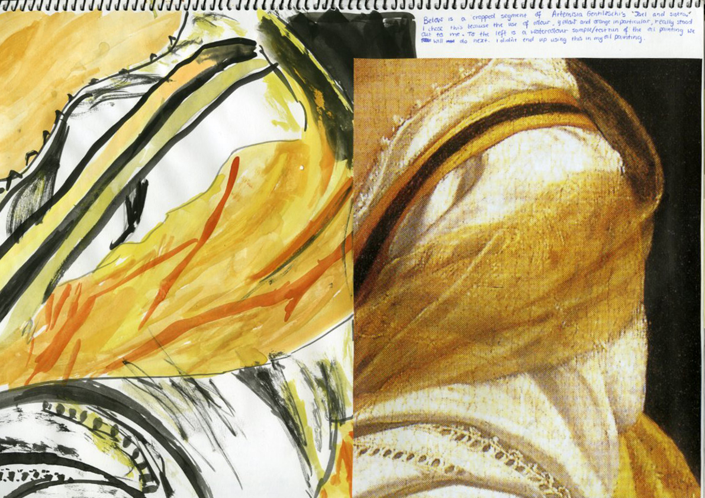
Student Examples

Slide 19
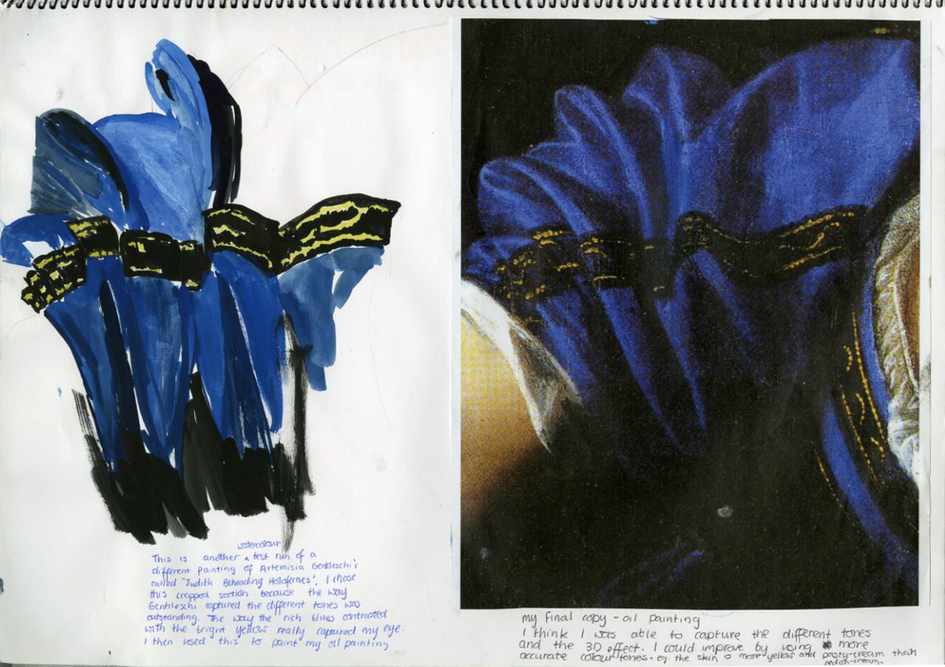
Student Examples

Slide 20
Good luck!
☺

