Slide 1
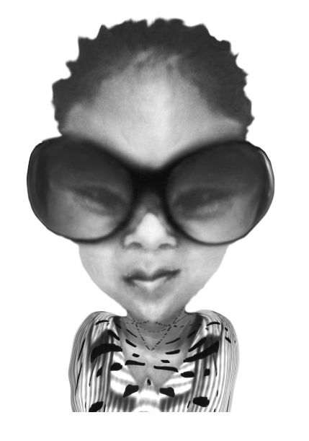
PASSIVE
DESTRUCTIVE
LITERACY
STUDENT VOICE
(Dreikurs, 2013)
Jen
DE-IDENTIFIED
(Nugent, 2000)
MULTICULTURAL
ANXIETY
‘Arts Language’ (AL)
Visual metalanguage used to analyse artwork
Notes:
SCHOOL CONTEXT
De-identified Melbourne (northern suburbs)
Middle class SES ; ICSEA -1088
Girls Catholic (7-12) : 1003 students
Minimal multicultural representations
SCHOOL POLICY
“Love of learning & literacy focus

Slide 2
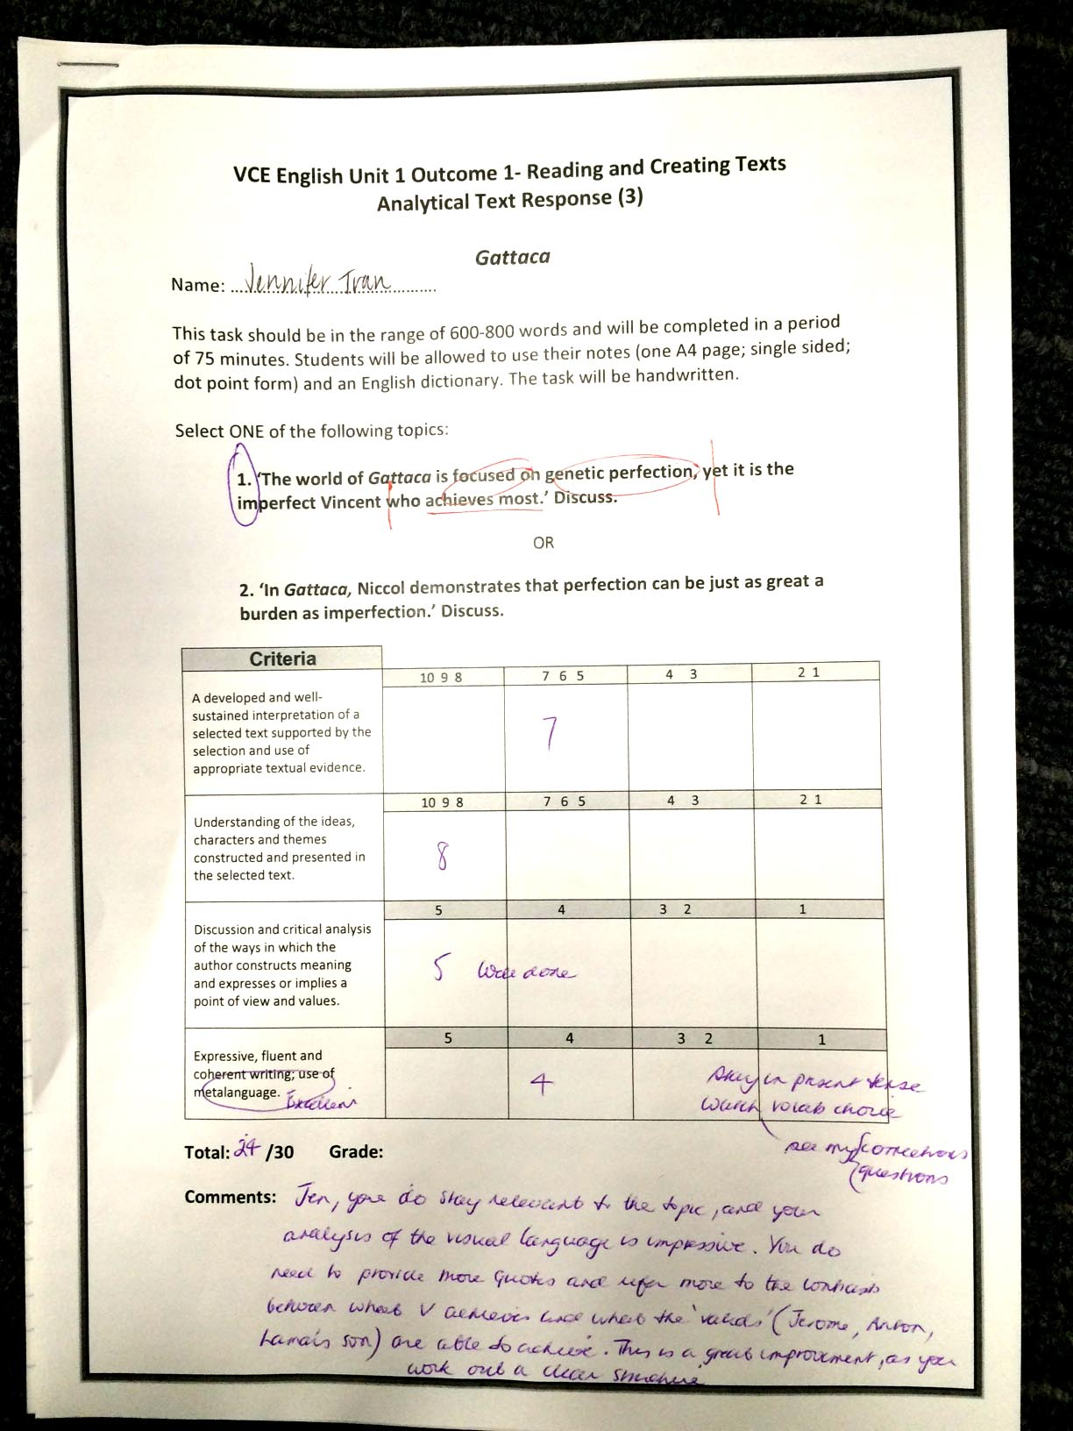

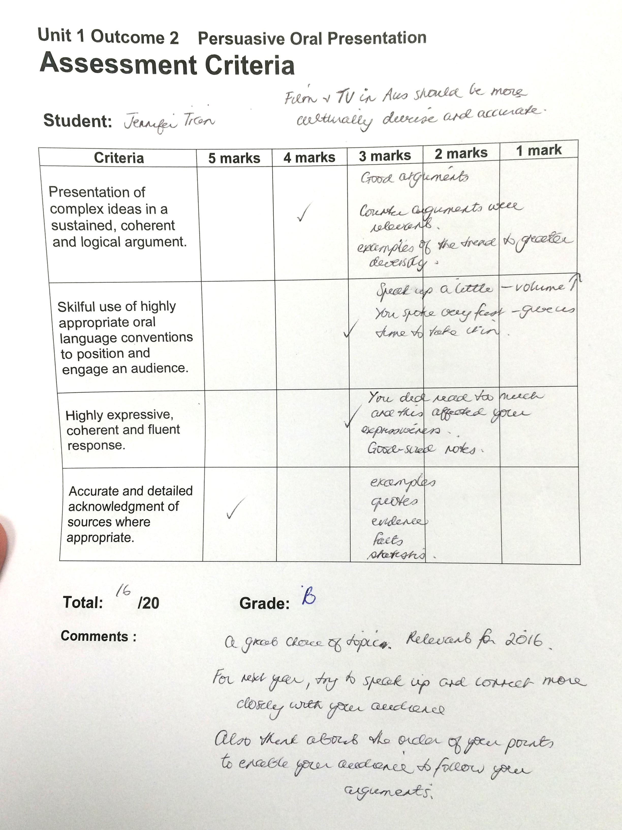
LEARNING NEED: Develop ‘Arts Language’
1
Impact on Arts Language
1. VCE structure
2. Cultural Background
3. Environment not conducive to
learning
“Nonverbal behaviour is the most
common way “poppy clipping” is
experienced…
DIAGNOSIS
(Phelps et al, 2012)
Prior Knowledge
1. Observational data
2. Academic transcript
3. Teacher feedback
(Mancl & Penington, 2011, p. 80)
“Unstructured writing”
“Speak up and connect”
* “reluctant to present knowledge”
Appendix 1
Notes:
PRIOR KNOWLEDGE:
+ Writes creatively,
interprets meaning
- design elements principles
(Phelps et al, 2012)
Traditional focus has been on rote memorization of text book information and passive learning approaches..
Tall poppy syndrome: (Mancl & penington, 2011)
“Many play small to avoid social exclusion” p 80

Slide 3
reflexive praxis
(plan, implement, observe, reflect, adjust plan)
clinical praxis cycle
– observe and gather evidence
read and plan
implement
observe and record
analyse, observe and gather evidence
CLINICAL PRAXIS:
Cyclical process of analysis & reflection,
integrating theory, evidence, practice & evaluation
Jen
2
2:1
2:2
Positive
learning
culture
Process
directed
feedback
INTERVENTION 2:
Understanding
metalanguage
FUTURE
INTERVENTIONS
1
INTERVENTION 1:
Diagnosis
3:1
3:2
Positive
learning
culture
Process
directed
feedback
3
INTERVENTION 3:
Critical thinking
Notes:
clinical praxis cycle
– observe and gather evidence
read and plan
implement
observe and record
analyse, observe and gather evidence

Slide 4
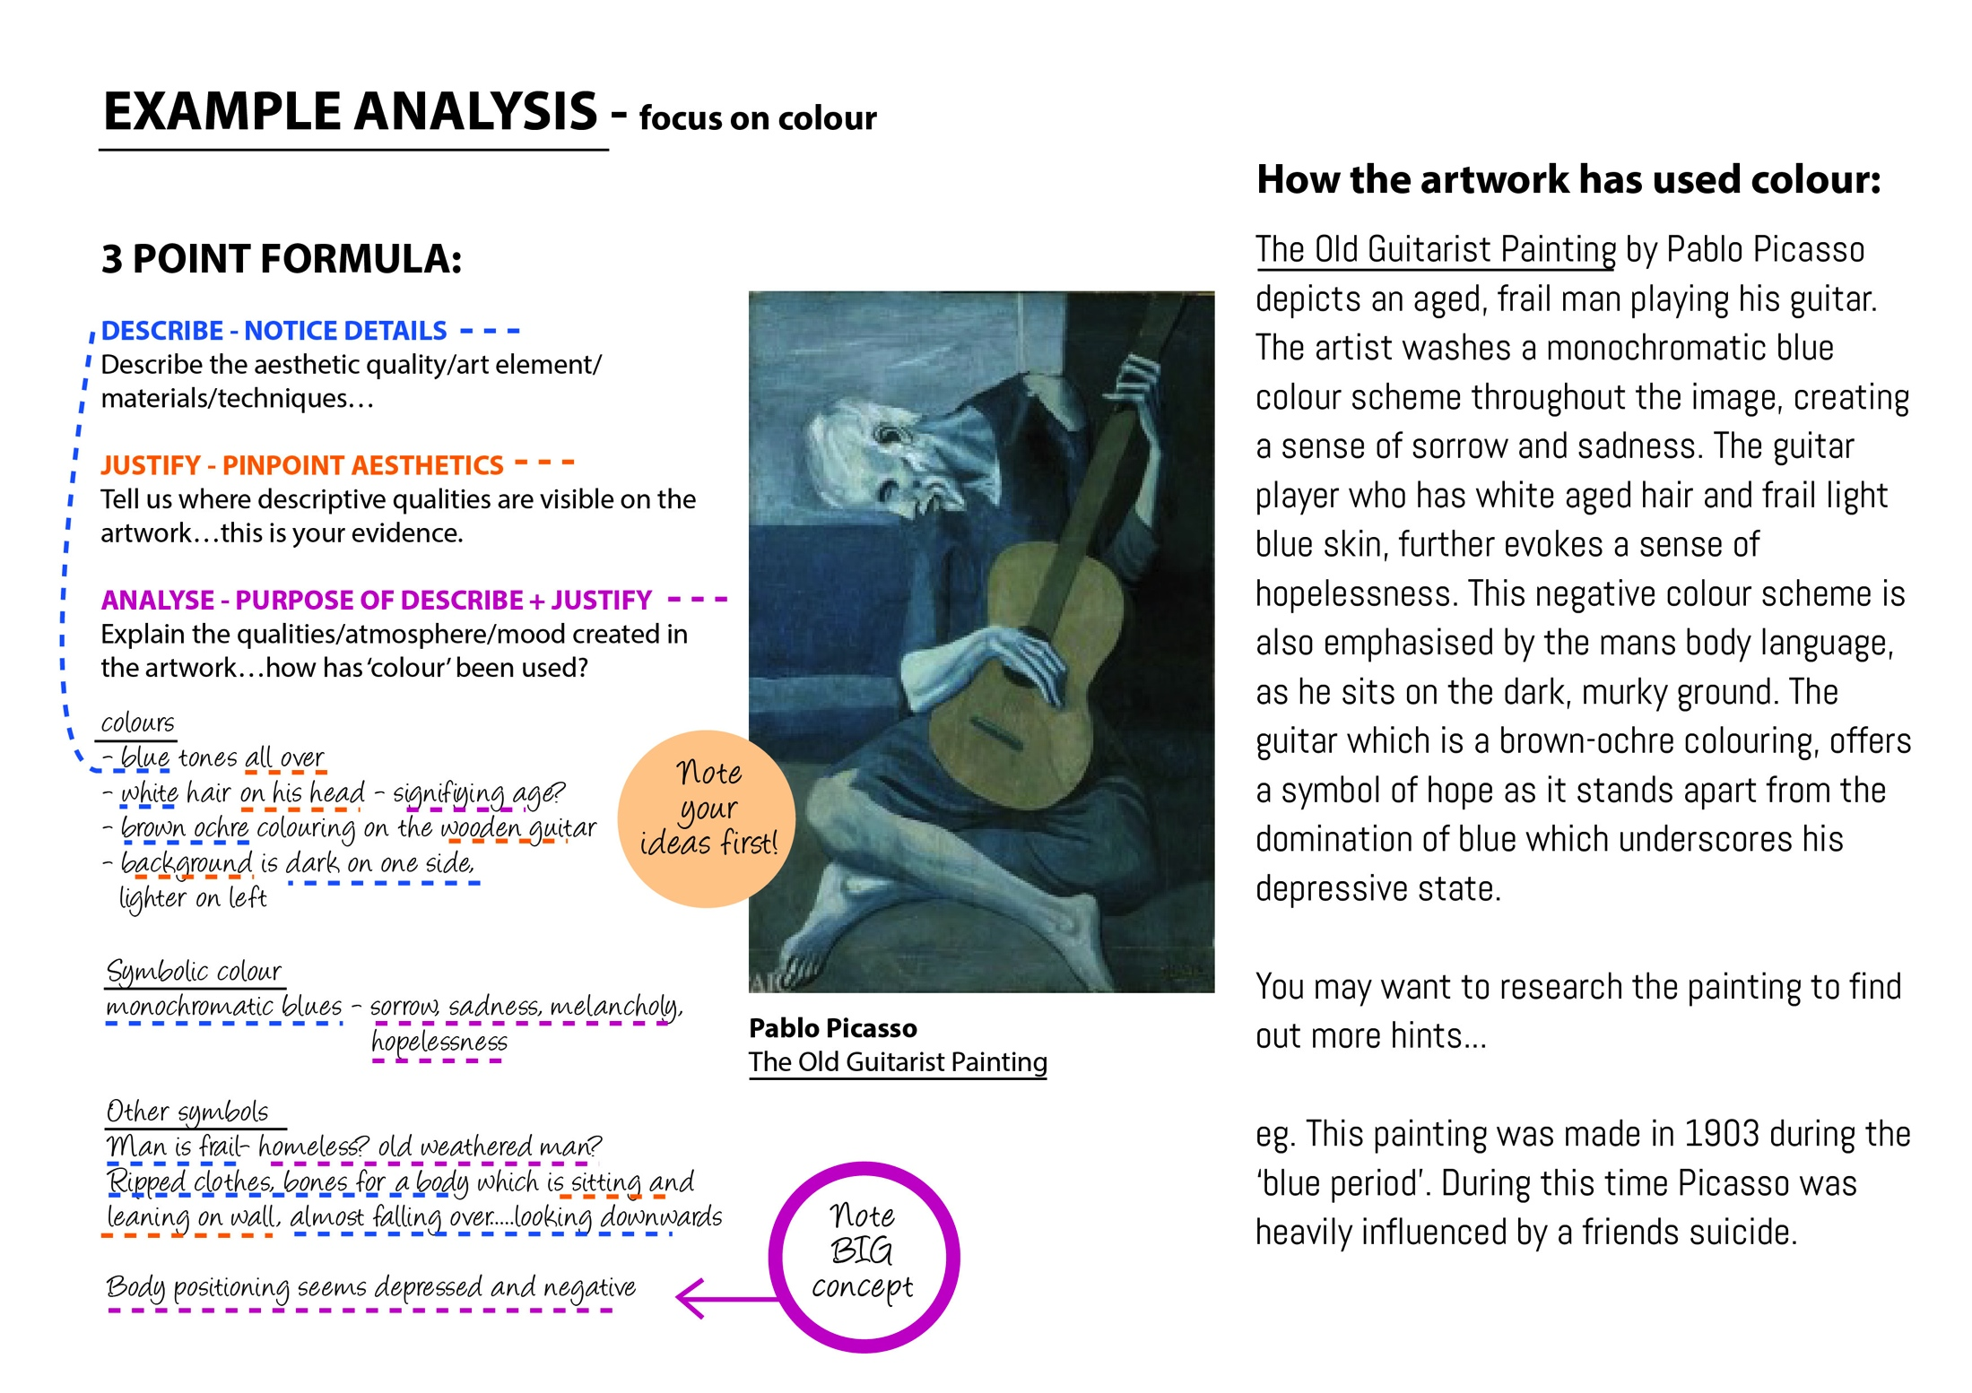
Recording 1 – results moderately successful.. Arts Language still unclear
Aims to facilitate structure
within AL (written & oral)
INTERVENTION 2:
UNDERSTANDING
METALANGUAGE
2
2:1
2:2
Positive
learning
culture
Process
directed
feedback
Visual Thinking Strategies
1. Scaffolding - ZPD (Appleby & Langer, 1983)
VCAA: VCE study design
Decoding of metalanguage – DCT (Clark & Paivio, 1991)
Modeling of feedback, audio, process
2. Multimodal – ‘building knowledge stage’
Oral recording
‘Imperfect process’ (Brashears & White, 2006)
Feedback – Feed up, back, forward (Hattie, 2009)
3. Humanist approach
Choice Theory (Wubbolding, 2007)
School policy - “Love of learning”
Appendix 2
Notes:
Structure required in order to synthesise ideas

Slide 5
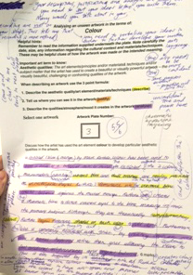
Aims to facilitate higher order
thinking & analysis (written & oral)
INTERVENTION 3:
CRITICAL
THINKING
3
3:1
3:2
ADJUSTMENTS:
Expand analysis, Refine ideas, articulation
Positive
learning
culture
Process
directed
feedback
Metacognition Strategies
1. Experiential learning (Kolb, 1984)
Exploratory talk celebrating diversity
2. Questioning
Authentic/open questions (Boyd & Rubin, 2006)
Peer formative Feedback (Hattie, 2009; Fielding, 2004)
3. Dialogic approach
‘Dialogical class’ (Friere, 1996)
Deferring questions (Boyd & Markarian, 2011)
Appendix 3
Notes:
Experiential learning (Kolb, 1984) – inclusive education

Slide 6

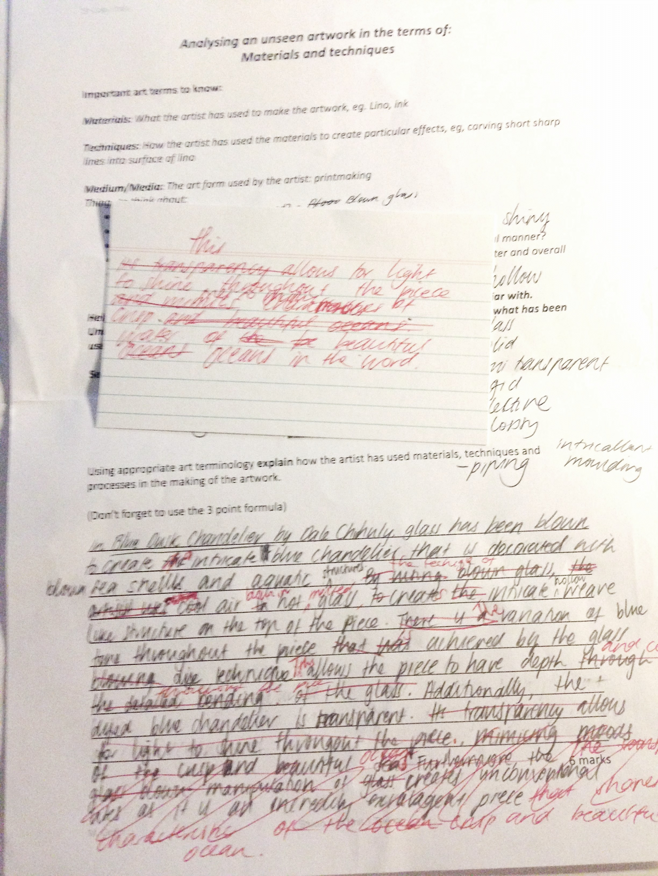
OUTCOMES: Jen’s use of Arts Language
JEN’s Results
I’m just not
good at
expressing
my ideas…
oral language edits written language
(Dweck, 2000)
Jen
FUTURE INTERVENTIONS:
GROWTH MINDSET
Debates
Group work – policy
Modeling error
Tackle social context
Feedback from Jen is vital (Hattie, 2009)
* Oral arts language is
awkward and unclear

Slide 7
REFERENCES:
Applebee, A., & Langer, A. (1983). Instructional scaffolding: Reading and writing as natural
language activities. Language arts, 60(2), 168-175.
Boud, D., & Molloy, E. (2013). Rethinking models of feedback for learning: the challenge of
design. Assessment & Evaluation in Higher Education,38(6), 698-712.
Boyd, M., & Markarian, W. (2011). Dialogic Teaching: talk in service of a dialogic stance.
Language and Education, 25, 6, 515-534.
Boyd, M., & Rubin, D. (2006). How contingent questioning promotes extended student talk: A
function of display questions. Journal of Literacy Research, 38(2), 141-169.
Brashears, K. & White, V. (2006). Strategies and Ideas for Teaching Writing in the Middle Years.
Literacy Learning: the Middle Years, 14, 2, 1-8.
Clark, J. M. & Paivio, A. (1991). Dual coding theory and education. Educational Psychology
Review, 3(3), 149–210.
Dreikurs, R., Grunwald, B., & Pepper, F. (2013). Maintaining sanity in the classroom: Classroom
management techniques. Taylor & Francis.
Dweck, C. (2000). Self-theories: Their role in motivation, personality, and development.
Psychology Press.
Dweck, C., & Leggett, L.(1988). A social-cognitive approach to motivation and personality.
Psychological Review, 95,256-273.
Fielding, M. (2004). ‘New Wave’ Student Voice and the Renewal of Civic Society, London
Review of Education, 2.
Freire, P. (1996). Pedagogy of the oppressed (Chapter 2). New York: Penguin.
Gibbs, G. (1988). Learning by doing: A guide to teaching and learning methods, Oxford
Center for Staff and Learning Development, Oxford Polytechnic. London: Further
Education Unit.

Slide 8
REFERENCES:
Hattie, J. (2009). Visible Learning: A synthesis of over 800 meta-analyses relating to
achievement. New York, Routledge Press.
Hattie, J., & Timperley, H. (2007). The Power of Feedback. Review of Educational Research.
77(1), 81-112.
Kolb, D. A. (1984). ‘The process of experiential learning’. In Experiential learning: Experience as
the source of learning and development (pp. 20-38). Englewood Cliffs: Prentice Hall.
Mancl, C., & Penington, B. (2011). Tall poppies in the workplace: Communication strategies
used by Envious Others in Response to Successful Women. Qualitative Research Reports
in Communication, 12(1), 79-86
Nugent, S. (2000). Perfectionism: Its manifestations and classroom-based
interventions. Prufrock Journal, 11(4), 215-221.
Paul, R., Elder, L., & Bartell, T. (1997). California teacher preparation for instruction in critical
thinking: Research findings and policy recommendations.
Phelps, R., Nhung, H., Graham, A., & Geeves, R. (2012). But how do we learn? Talking to
Vietnamese children about how they learn in and out of school. International Journal of
Educational Research, 53, 289-302.
School website: http://www.*****.vic.edu.au/- de-identified;
https://www.myschool.edu.au/SchoolProfile/Index/87071/*Ltd/45748
Schunk, D. (2008). ‘Constructivist Theory’. In Learning Theories: An Educational Perspective
(pp. 234-277). Fifth Edition. Upper Saddle River: Pearson, Perrill Prentice Hall.
Victorian Curriculum and Assessment Authority. (2014). Visual Arts: Structure. Retrieved from http://victoriancurriculum.vcaa.vic.edu.au/thearts/visualarts/introduction/structure
Wubbolding, R. (2007) Glasser Quality School. Group Dynamics: Theory, Research and
Practice. American Psychological Association. 11, 4, 253-261.

