Slide 1
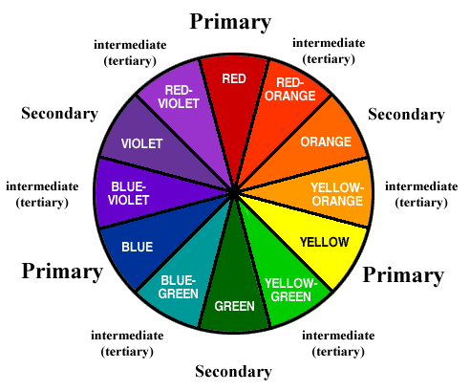

Slide 2
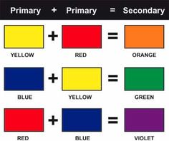

Slide 3
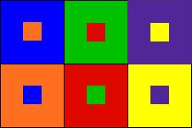

Slide 4
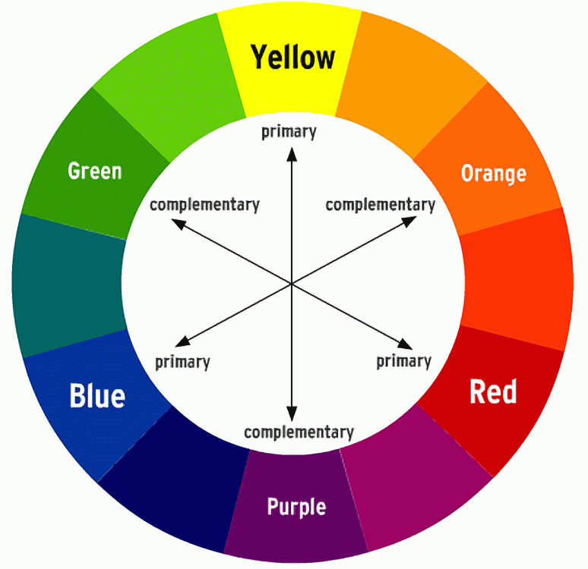

Slide 5
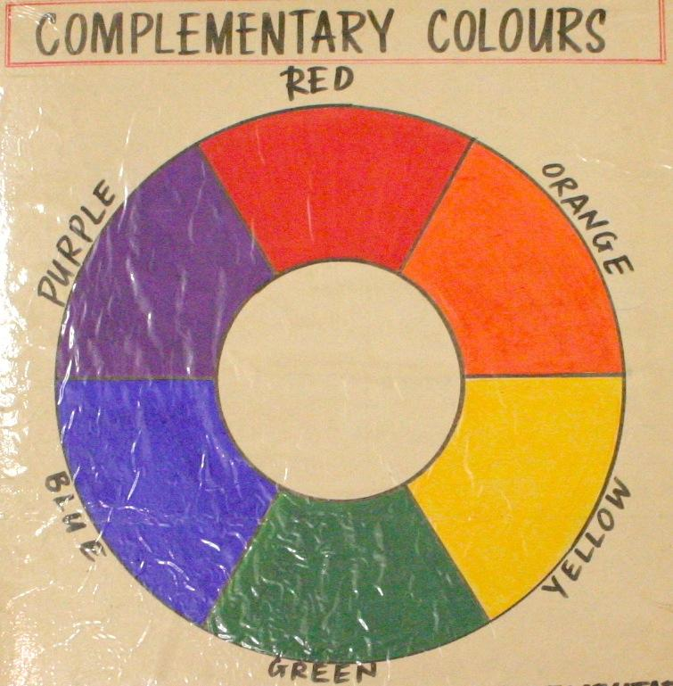
Henri Matisse mid life painting style

Slide 6
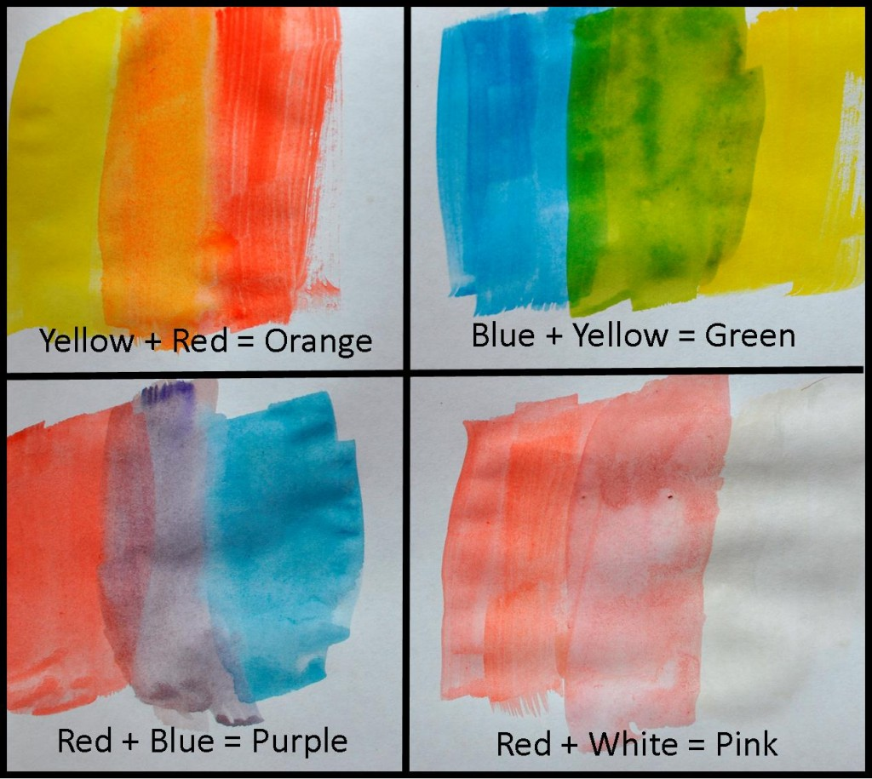

Slide 7
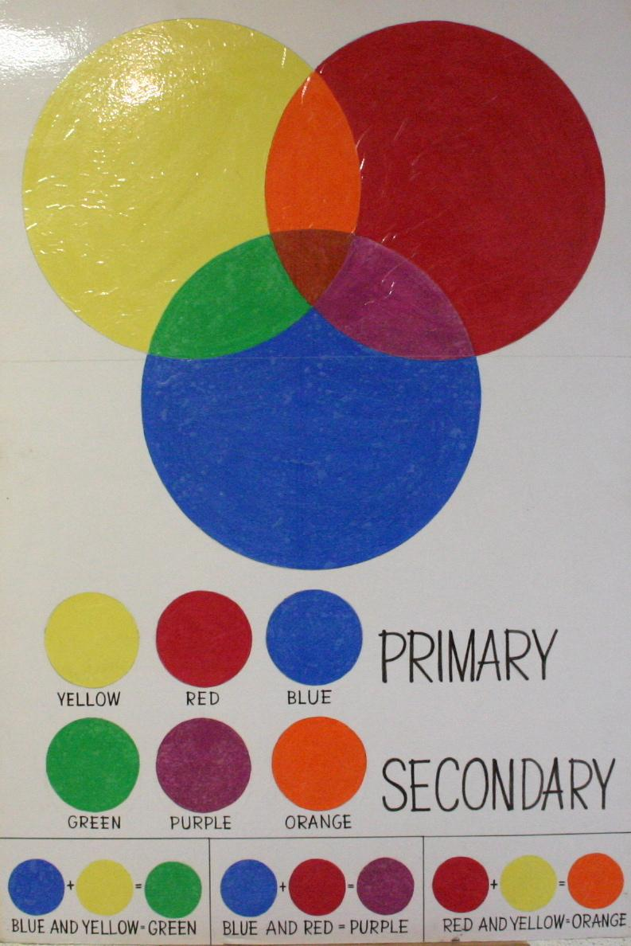

Slide 9
Henri Matisse’s
last working style was cutting paper to make
large collages
In 1906, Matisse met Pablo Picasso and they became good friends.
Matisse started to create large scale cut paper collages. He called the technique ‘painting with scissors’.

Slide 10
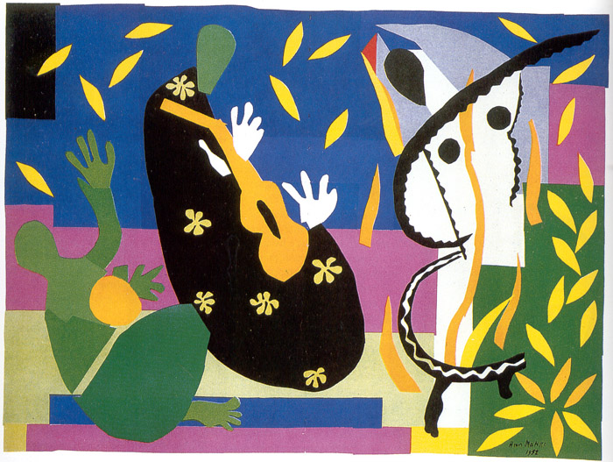
Henri Matisse, paper cut out collage

Slide 11
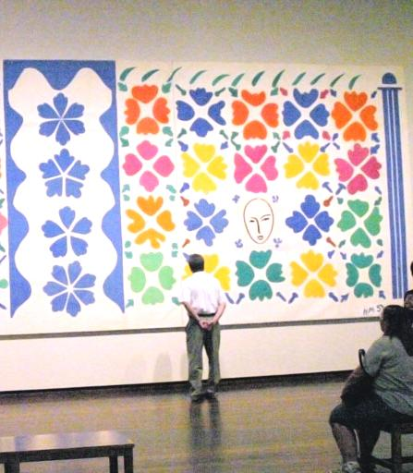
Henri Matisse dies in 1954
Henri’s daughter, Marguerite, was a member of the French Resistance during World War 2. She was captured and was sent to the Ravensbruck concentration camp. Luckily, she managed to escape from the train.
Matisse died of heart failure in 1954.
He was 84.
Matisse’s son, Pierre, opened a gallery in New York. He exhibited the work of many great modern artists (in addition to the work of his father), such as: Joan Miro, Alberto Giacometti and Marc Chagall.

Slide 12
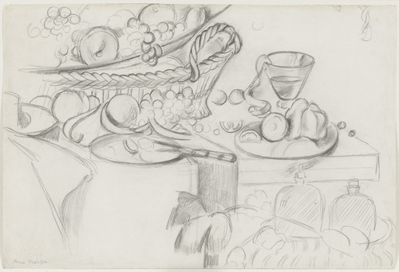
Henri Matisse was also very good at drawing,
here are some examples of his still life drawing work

Slide 13
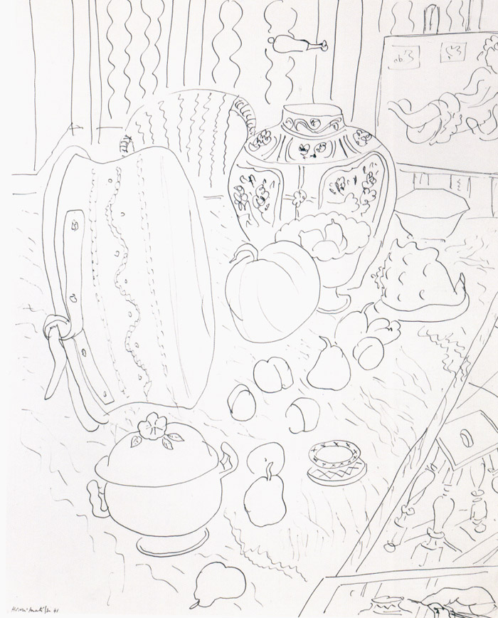
Example of Henri Matisse’s still life drawing work.

Slide 14
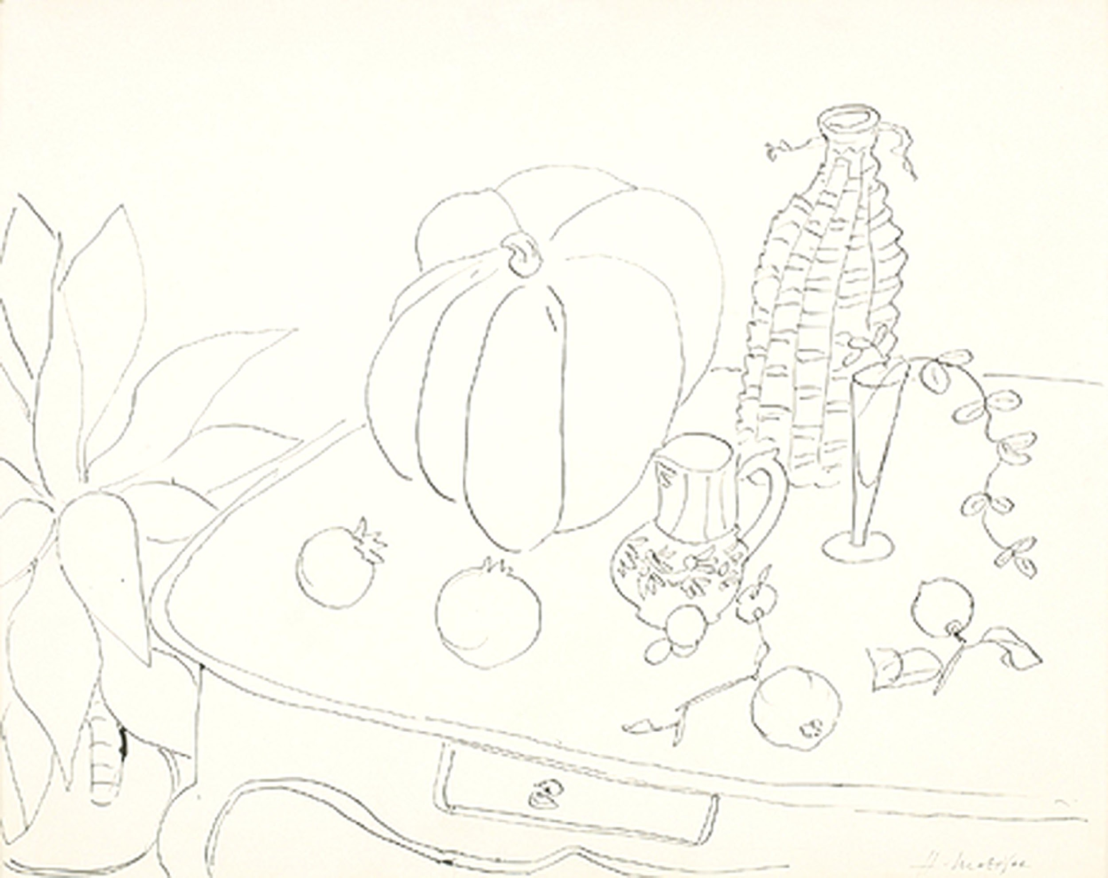
Example of Henri Matisse’s still life drawing work.
This drawing was made in 1941 and is called “Still Life with Pumpkin” and recently sold at auction for $180,000.

Slide 15
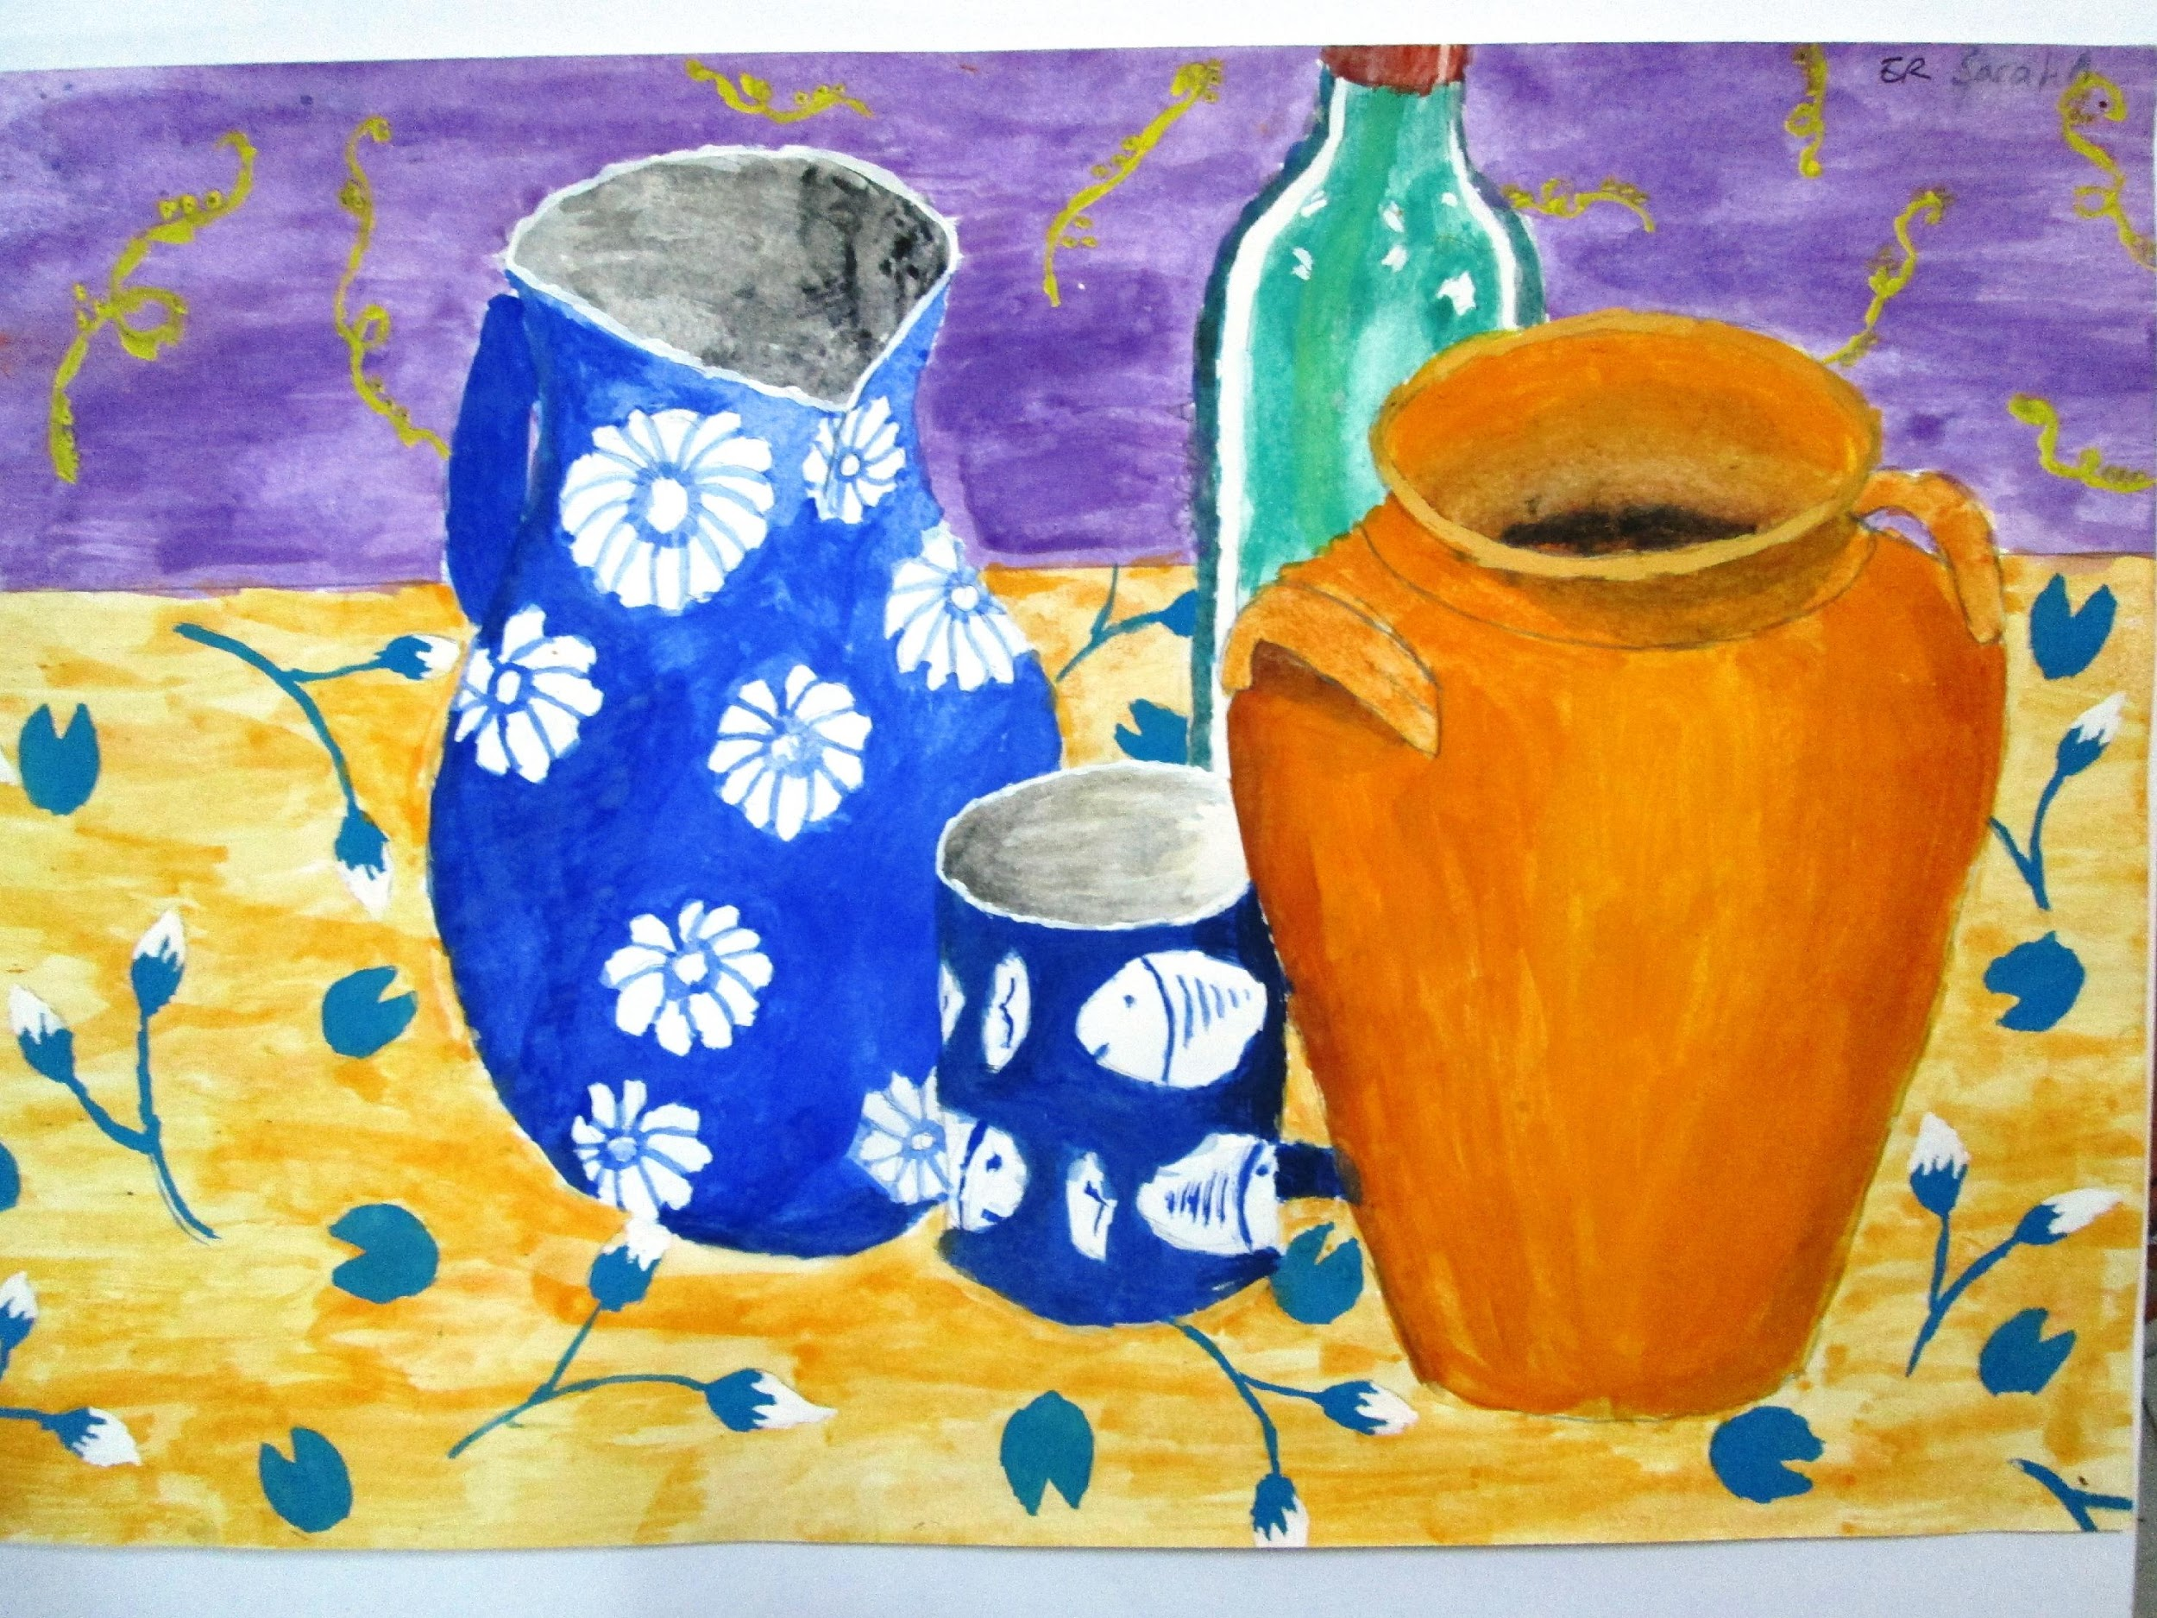
Now it is your turn to make a painting in the style of Henri Matisse’s mid life painting style. Here are some examples of paintings done by students who are the same age as you.

Slide 16
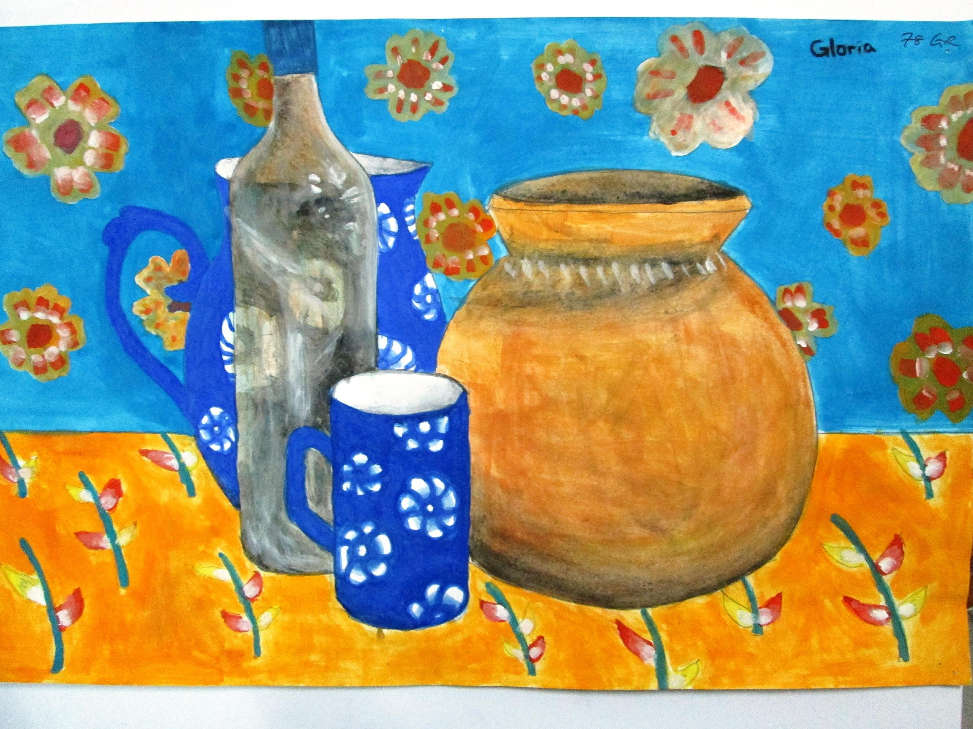
Matisse inspired painting made by a student

Slide 17
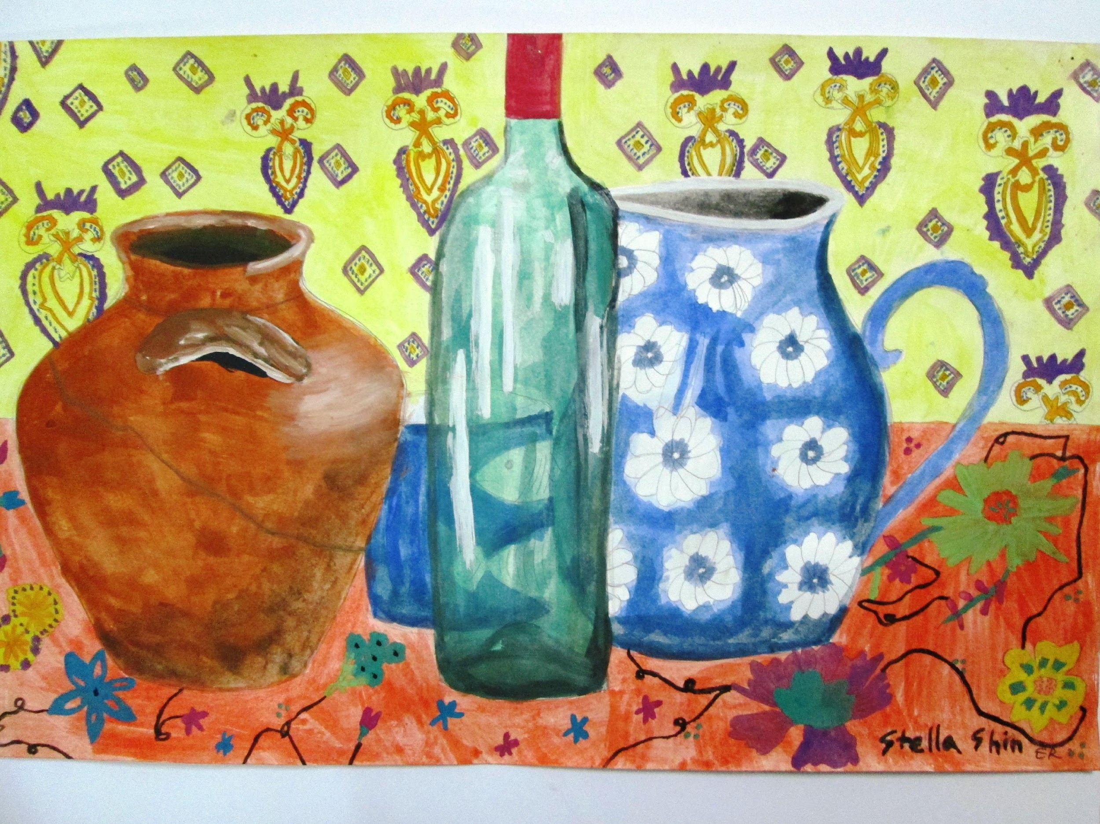
Matisse inspired painting made by a student

Slide 18
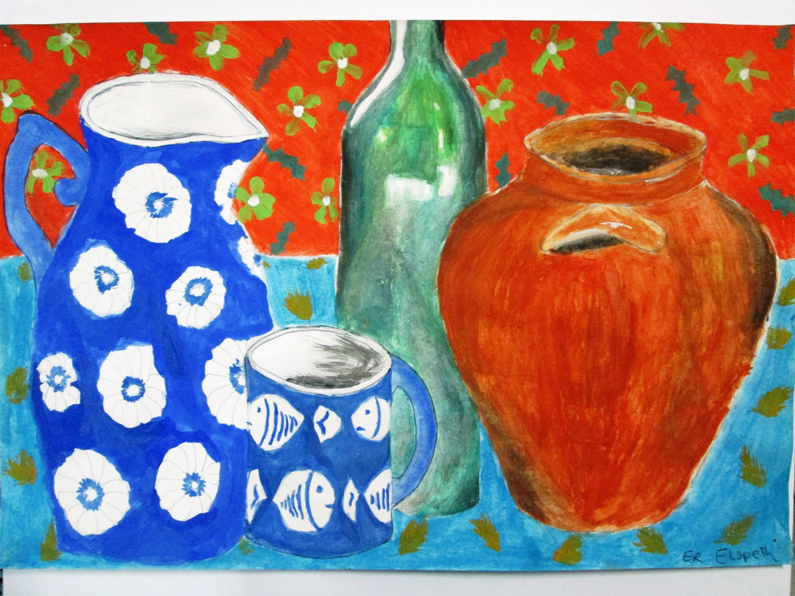
Matisse inspired painting made by a student

Slide 19
How to get started on your Matisse inspired painting.
Your painting must show the following skills:
(You will be graded on the following 7 elements.)
Accurately drawn ovals
Accurately drawn symmetry of objects
Accurate proportion and shape of objects
Accurately painted objects showing light and shade
Accurate reflection and texture details on objects
Background patterns simplified
Background patterns painted using complementary colours

Slide 20
How to get started on your Matisse inspired painting.
Step one – Arranging the objects
First arrange (COMPOSE) 4 overlapping objects on a table with the patterned table cloth as a background. You will need to choose one tall bottle and then 3 other items such as cups, bowls and pots to make a strong COMPOSITION.

Slide 21
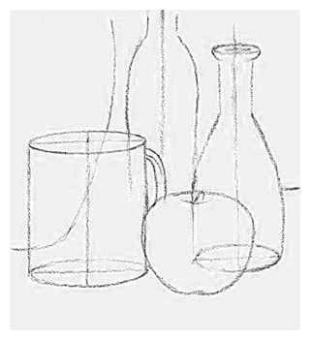
How to get started on your Matisse inspired painting.
Step two – Line Drawing of objects

Slide 22
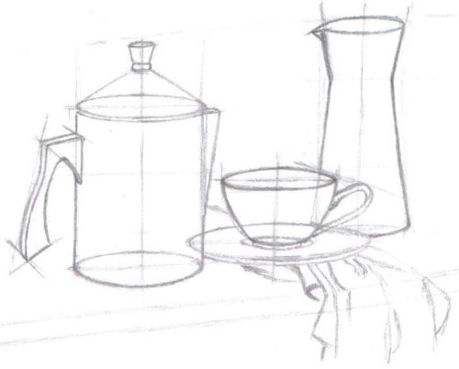
How to get started on your Matisse inspired painting.
Step two – Line Drawing of objects

Slide 23
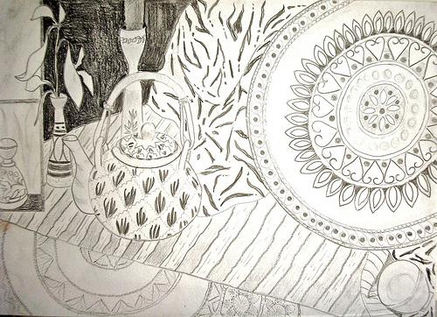
How to get started on your Matisse inspired painting.
Step three – Add your line drawing of the background patterns

Slide 24
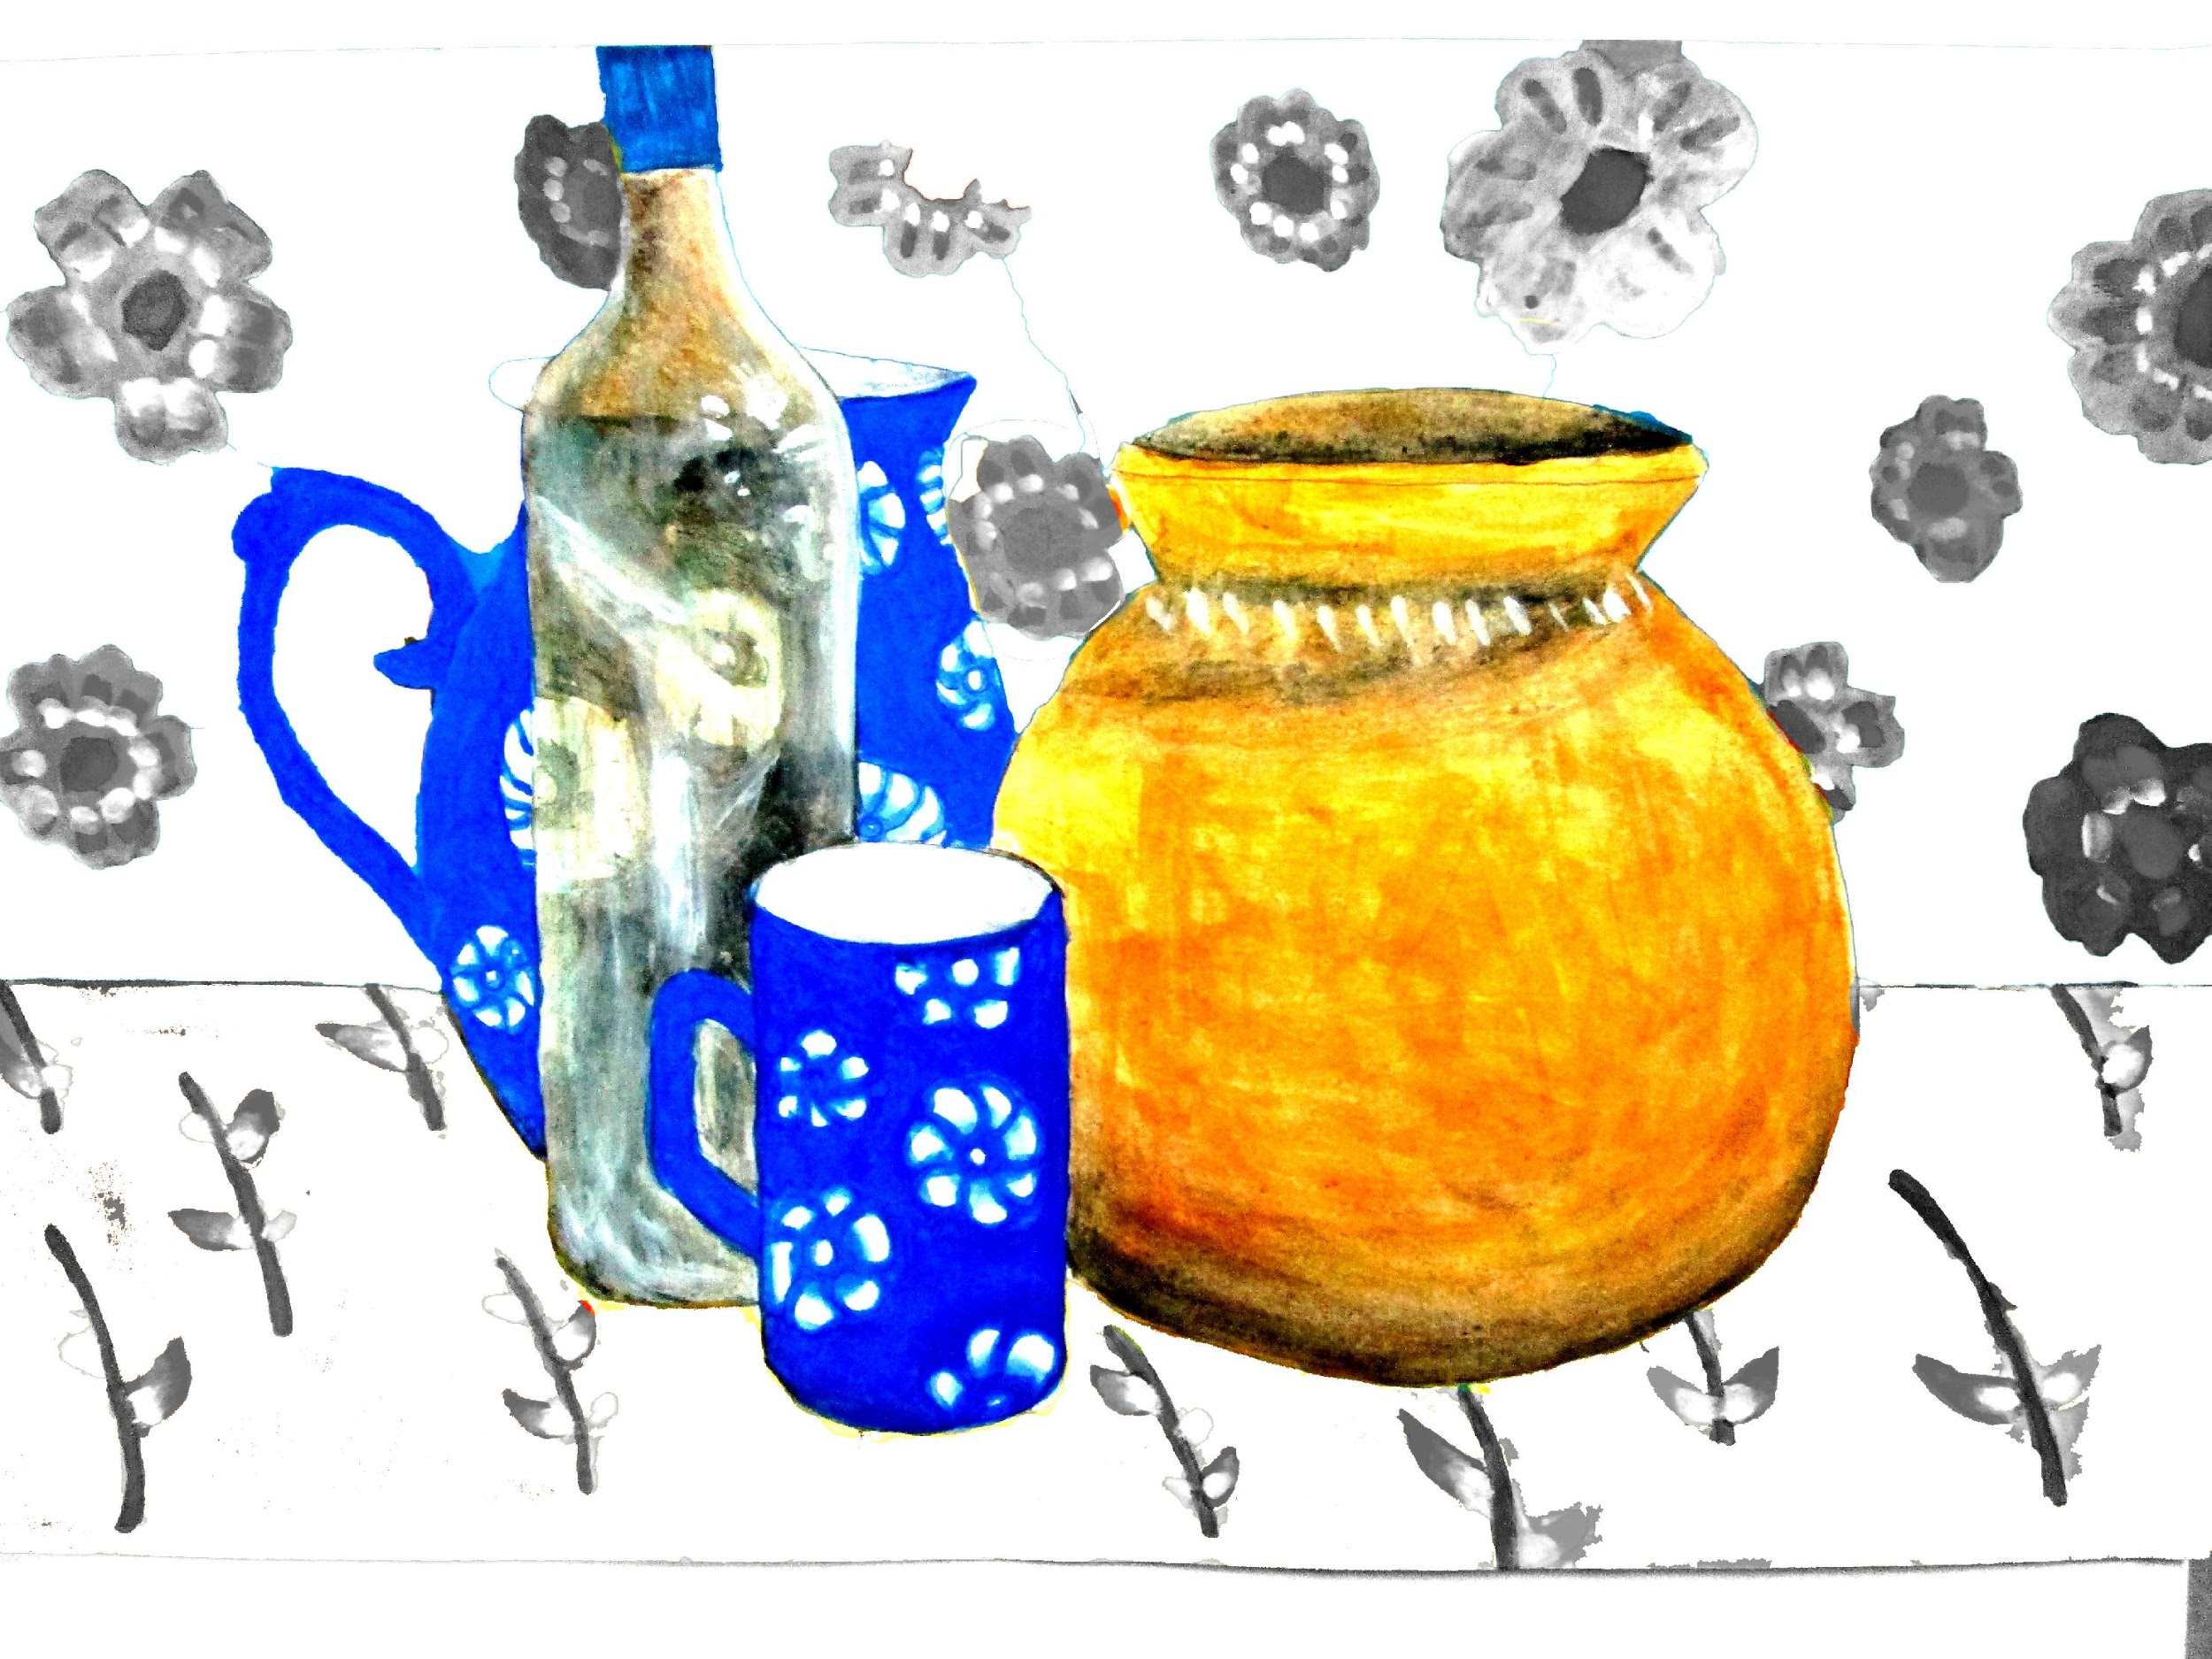
How to get started on your Matisse inspired painting.
Step four: Paint the objects realistically showing shadow, highlights and reflections

Slide 25
How to get started on your Matisse inspired painting.
Step five: Chose your complementary colours for the background patterns.
Red is complementary to green, blue is complementary to orange &
Yellow is complementary to purple.

Slide 26
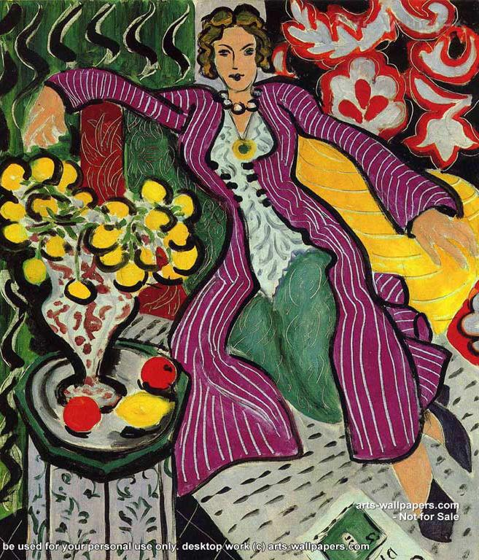
Henri Matisse used complementary colour pairs in his paintings to make his pictures dazzle with colour. In this painting he places the complementary colours yellow and purple next to each other.

Slide 27
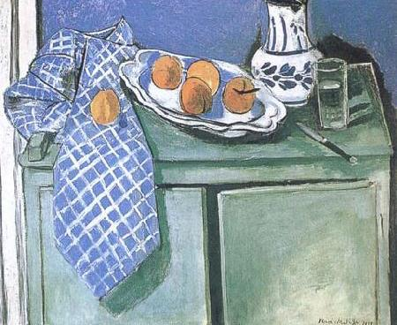
Matisse’s used blue and orange complementary colours.

Slide 28
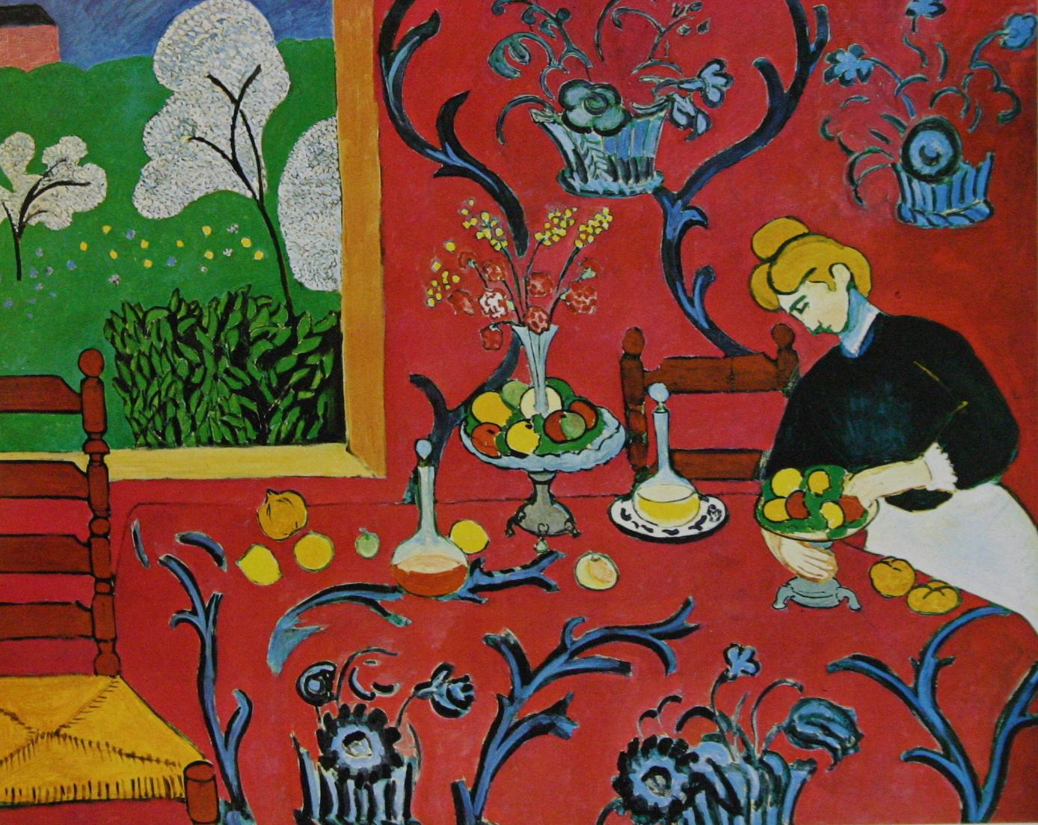
Matisse’s used red and green complementary colours.

Slide 29
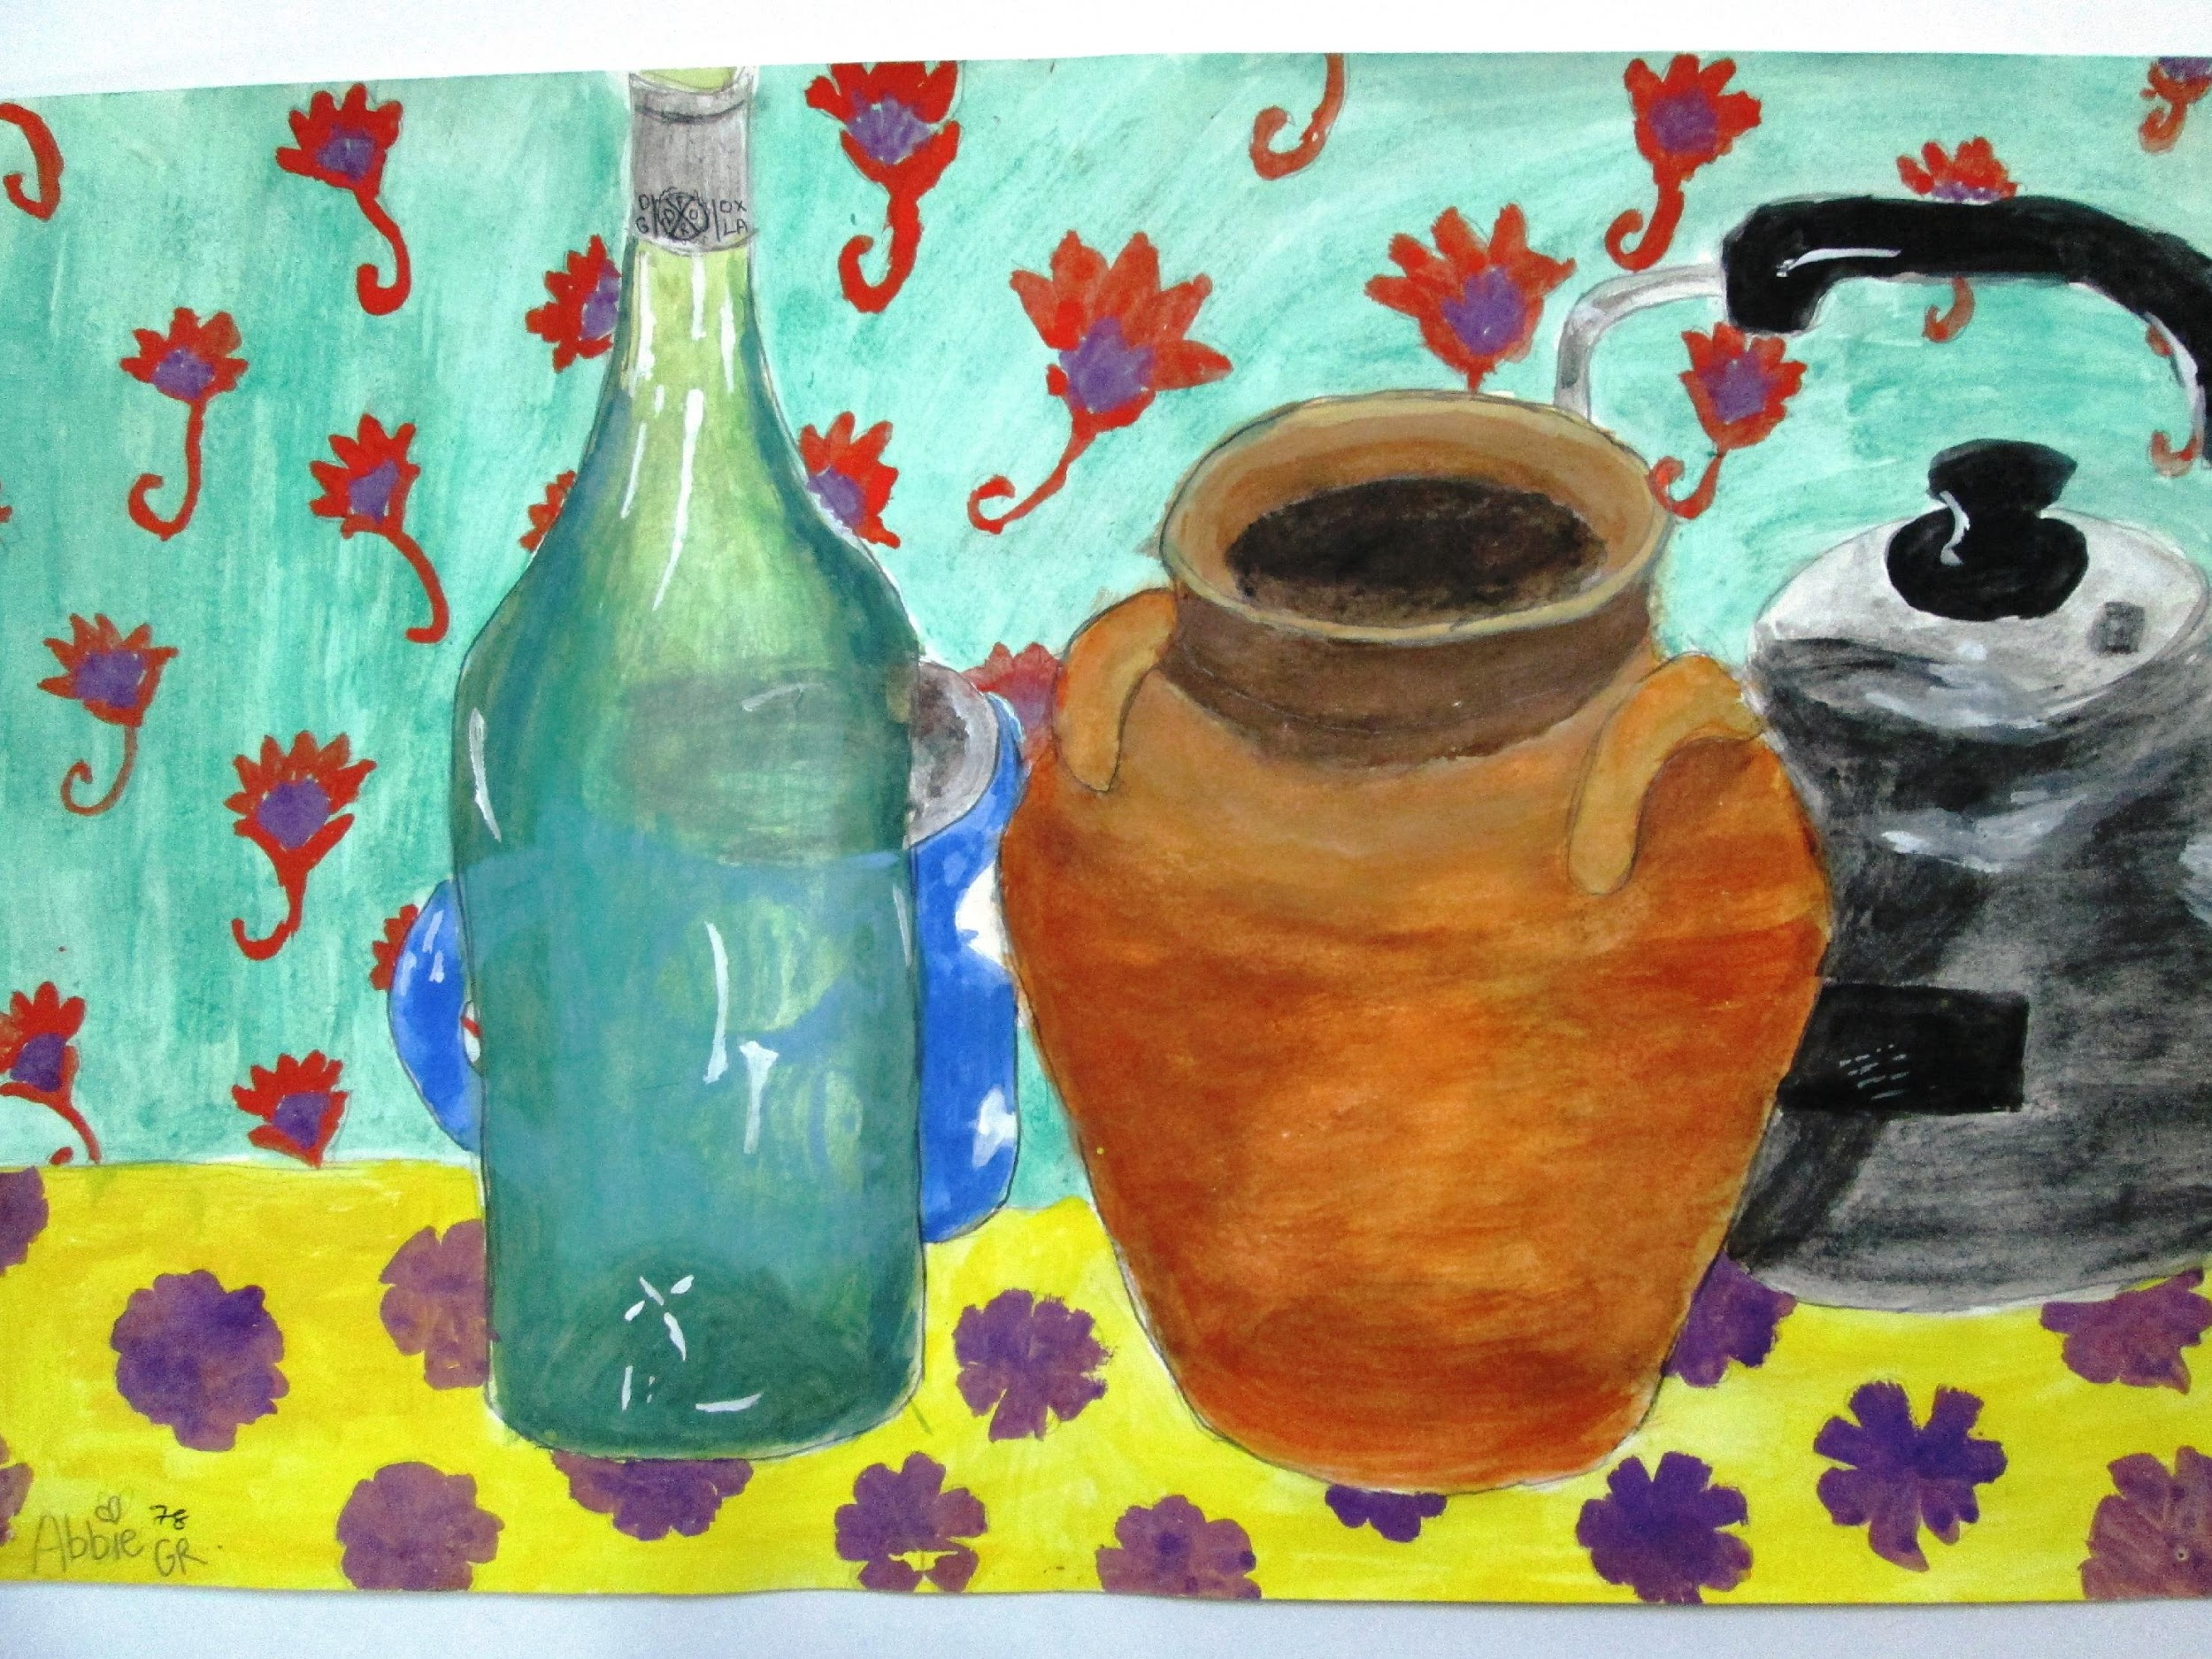
How to get started on your Matisse inspired painting.
Step five:Paintyour complementary colours
for the background patterns.
Red is complementary to Green,
Blue is complementary to Orange
Yellow is complementary to Purple.

